Slide 1
TERMS AND CONDITIONS
These PowerPoint slides are a tool for lecturers, and as such:
YOU MAY add content to the slides, delete content from the slides, print out the slides, and save the slides onto your computer or server.
YOU MAY NOT resell, reproduce or redistribute the content in any form whatsoever, without prior written permission from the copyright holder.
© Troupant Publishers (Pty) Ltd, 2016
Selected images used under licence from Shutterstock.com

Slide 2
Engineering Technology
NQF Level 2

Slide 3
SI units of measurement
Topic 5

Slide 4
SI units of measurement
Module 5

Slide 5
SI base units of measurement
Unit 5.1

Slide 6
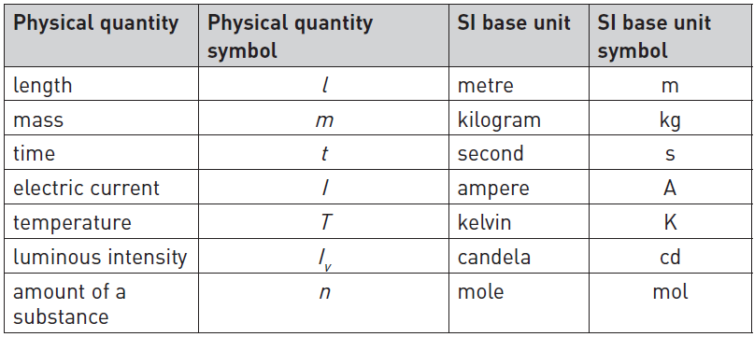
SI base units
Table 5.1: The seven SI base units

Slide 7
Metre (m)
A metre is the length of the path travelled by light in a vacuum during a time interval of of a second.

Slide 8
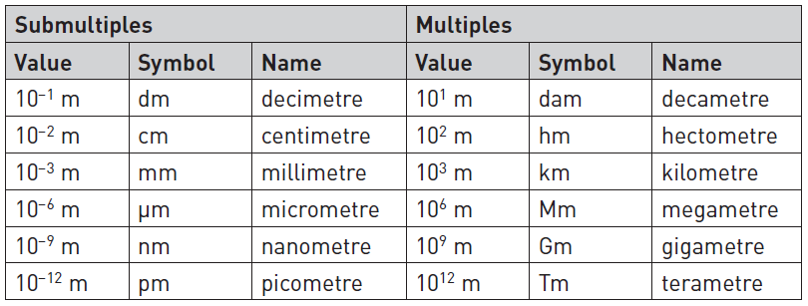
Metre (m)
Table 5.2: SI multiples for the metre (m)

Slide 9
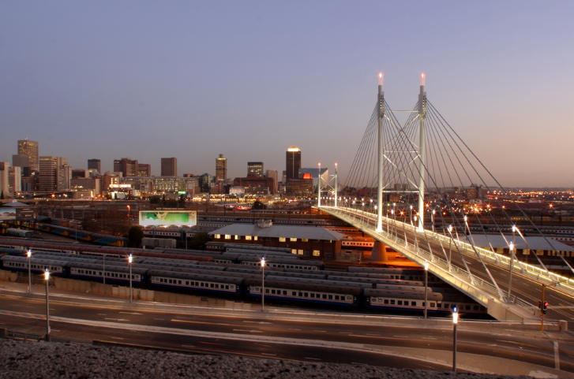
Metre (m)
Figure 5.3: The length of the Nelson Mandela bridge in Johannesburg is 284 m

Slide 10
Kilogram (kg)
A kilogram is equal to the mass of the international prototype kilogram (IPK).

Slide 11
Second (s)
A second is the length of time taken for 9 192 631 770 periods of vibration of the caesium-133 atom to occur.

Slide 12
Ampere (A)
An ampere is the constant current that produces an attractive force of 2 × 10^{–7} newton per metre of length between two straight, parallel conductors of infinite length and negligible circular cross section placed one metre apart in a vacuum.

Slide 13
Kelvin (K)
A kelvin is of the difference between absolute zero and the triple point of water.

Slide 14
Candela (cd)
A candela is the luminous intensity, in a given direction, of a source that emits monochromatic radiation of frequency 540 × 10¹² hertz and that has a radiant intensity in that direction of watt per steradian.

Slide 15
Mole (mol)
A mole is the amount of substance that contains as many particles as there are atoms in 0,012 kg (12 g) of the isotope carbon-12.

Slide 16
Mole (mol)
Aspirin has the formula C9H8O4.
1 mol of aspirin contains:
9 mol of carbon atoms.
8 mol of hydrogen atoms.
4 mol of oxygen atoms.
Figure 5.4: An aspirin tablet

Slide 17
Converting SI units
Unit 5.2

Slide 18
Scientific notation
All numbers are written as follows: a × 10^{b}
Table 5.3: Conversions between decimal and scientific notation

Slide 19
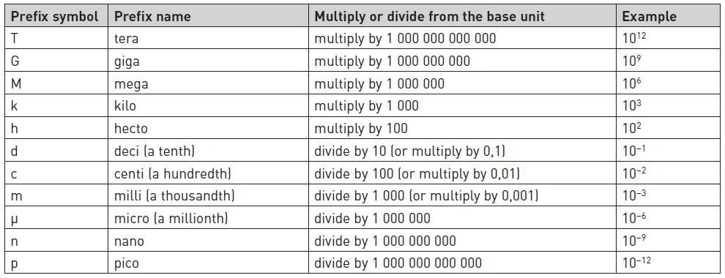
Common prefixes
Table 5.4: Common prefixes and their meanings

Slide 20
Common metric conversions
Table 5.5: Some common metric conversions

Slide 21
Temperature conversion
Table 5.9: Kelvin temperature conversion formulae

Slide 22
Temperature conversion
Table 5.10: Fahrenheit temperature conversion formulae

Slide 23
SI derived units of measurement
Unit 5.3

Slide 24
Speed
Speed is the rate of change in position of an object.
Speed is a scalar quantity.

Slide 25
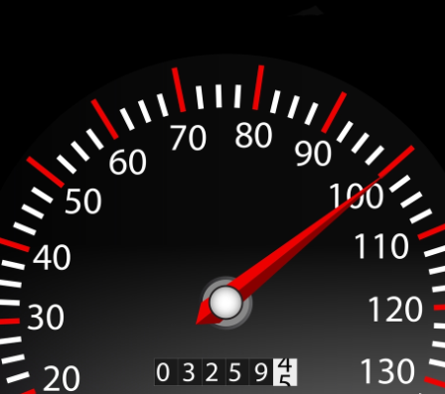
Speed
Figure 5.9: A speedometer

Slide 26
Velocity
Velocity is the rate of displacement of an object.
Velocity is a vector quantity.

Slide 27
Acceleration
Acceleration is the rate of change in velocity per unit time.

Slide 28
Force
A force is an influence that changes the motion of a body or produces motion or stress in a free body.

Slide 29
Force
The newton (N) is the SI unit of force.

Slide 30
Force
Figure 5.10: 1 N is required to accelerate a body with a mass of 1 kg at 1 m/s²

Slide 31
Weight
For the pull of gravity, the force equation can be written as:
The weight of an object is the force with which the earth attracts the object.

Slide 32
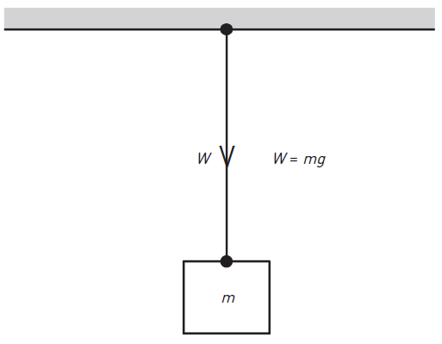
Weight
Figure 5.11: Weight of an object

Slide 33
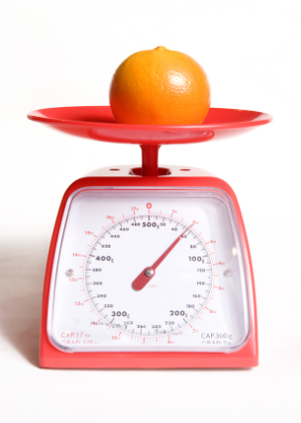
Mass
Mass is the amount of matter contained in an object and may be found by using ordinary scales.
Figure 5.12: Using a scale to find the mass of an orange

Slide 34
Work and energy
Work is done whenever a force moves along with, or acts all the time on, an object to displace it.
The SI unit of work is the joule.

Slide 35
Work and energy
Figure 5.13: A force of 1 N moves an object a distance of 1 m

Slide 36
Torque
Torque is a turning moment produced by a force.

Slide 37
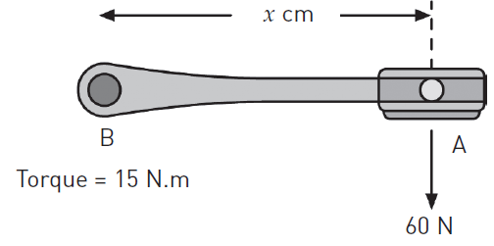
Torque
Figure 5.14: Calculate distance x

Slide 38
Resistance
The resistance of an electrical element is a measure of its opposition to an electric current.
The ohm (Ω) is the SI unit of electrical resistance.

Slide 39
Density
The density of an object is defined as its mass per unit volume.

Slide 40
Pressure
Pressure is the force per unit area applied in a direction perpendicular to the surface of an object.
The pascal (Pa) is the SI unit of pressure.

Slide 41
Power
Power is the rate of energy transfer.
The watt (W) is the special name given to the joule per second (J/s).

Slide 42
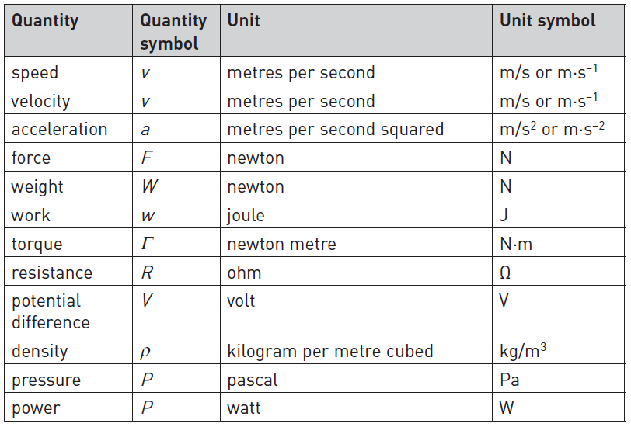
Table 5.11: Summary of terms, unit and their symbols

Slide 43
Measuring plane and solid angles
There are two units that we use to measure plane and solid angles:
Plane angle: radian (rad).
Solid angle: steradian (sr).

Slide 44
Radian (rad)
The radian is defined as the plane angle between the two radii of a circle that are cut off on the circumference of an arc of length equal to the radius of that circle.

Slide 45
Radian (rad)
Note:
radians = 180°
1 radian ≈ 57,3°

Slide 46
Steradian (sr)
The steradian is defined as the solid angle subtended at the centre of a sphere by an area of its surface equal to the square of the radius of the sphere.

Slide 47
Steradian (sr)

Slide 48
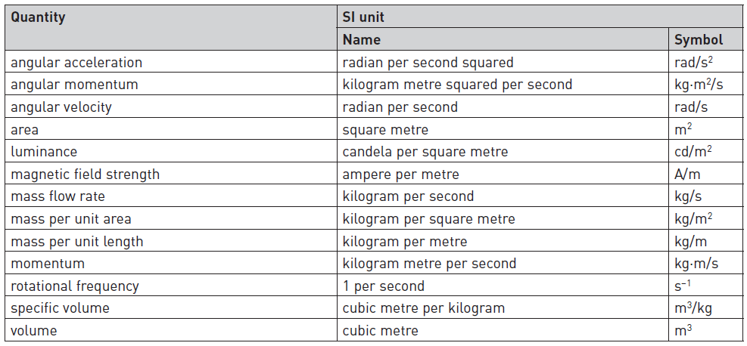
Other SI derived units
Table 5.12: Examples of derived units

Slide 49
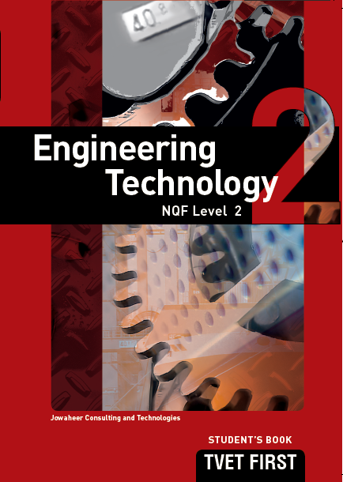
Summative assessment
Complete the
Summative assessment on page 199 of the Student’s Book.

Slide 50
1. List the seven SI base units of measurement
Metre for length.
Kilogram for mass.
Second for time.
Ampere for electric current.
Kelvin for temperature.
Candela for luminous intensity.
Mole for the amount of substance.

Slide 51
2. Copy and complete the table below.
Table 5.12: Examples of derived units
Without SI prefix | With SI prefix
a) 2 000 W | 2 kW
b) 5 500 g | 5,5 kg
c) 15 000 Pa | 15 kPa
d) 1 000 000 J | 1 MJ
e) 2 500 V | 2,5 kV

Slide 52
3. State the SI units of each of the following quantities:
Area
Volume
m²
m³

Slide 53
4. State whether the following are true or false:
The prefix M stands for milli.
The prefix k means multiply by 100.
To convert mm to cm, you must multiply by 10.
To convert km to m, divide by 1 000.
When you convert 100 cm³ to ^{m3}, the answer is 1 × 10^{–2} m³.
False
False
False
False
False

Slide 54
5. Define the following terms:
Density
Potential difference
Power
is the object’s mass per unit volume.
(or voltage) is the difference in electrical potential between two points in a circuit. It is the work done to move one unit of charge between two points in a circuit and is measured in volts (V).
is the rate of energy transfer.

Slide 55
The Rathete family are going on holiday to Cape Town. The family consists of Mr and Mrs Rathete and their two children, Prince and Beauty. Mr Rathete calculated the distance from his house in Houghton, Gauteng to Manenberg, CT as 1 800 km.
What is this distance in metres?
Mrs Rathete packs 2 l of mango juice for the long trip. How many millilitres is 2 l?
Prince estimates the total weight of the entire luggage as 50 kg. Convert the weight into grams.
Beauty pours 500 ml of oil into the engine. How many litres did Beauty pour into the engine?
1 800 000 m
2 000 ml
50 000 g
0,5 l

Slide 56
A force of 20 N is applied at the end of a handle 500 mm in length. The handle is rotated five complete revolutions. Calculate how much work is done.

Slide 57
Maria has a body temperature of 101 °F. What is the temperature equivalent on the Celsius scale?

Slide 58
9. Calculate the force required to accelerate a body with a mass of 750 g at 10 m/s.

Slide 59
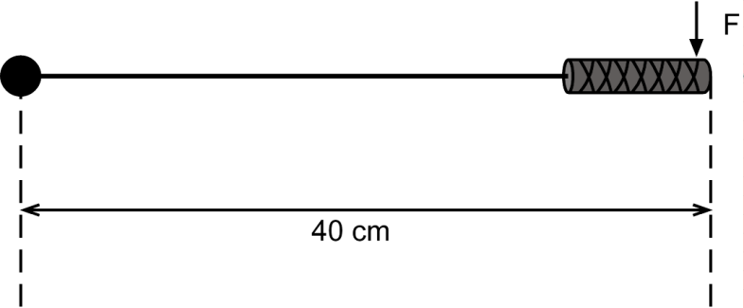
A torque wrench is used as shown in Figure 5.17. Calculate the force F required to produce 25 N·m of torque.
Figure 5.17: Using a torque wrench

Slide 60
A torque wrench is used as shown in Figure 5.17. Calculate the force F required to produce 25 N·m of torque.

